Slide 1
BLUETOOTH OPERATED AUTOMATED MINI VACUUM CLEANER
Submitted by
PALLAVI
SANJANA
KOMAL

Slide 2
INTRODUCTION
Through this project, the developer is able to play, improve and be tested in multiple number of areas.
You can say it is a "multiple knowledge" project, because you will need abilities and to learn in the fields of mechanical, electrical engineering, computer programming and calculus / numerical methods in general.
Your capacity of solving problems will be tested, and to be successful you will need also a certain dose of creativity.

Slide 3
COMPONENTS
2WD robot, one motor for each wheel;
Cleaning is done using a carpet sweeper ;
Motors are controlled separately through two H-bridges;
Uses PID control method, implemented via Arduino;
Rechargeable battery capable of running around for about an hour;
Bluetooth Module

Slide 4
Step 1: What Do You Need?
THE PARTS:
2WD car chassis
HC-06 Bluetooth module
2 x Dual H-bridges
Rechargeable battery above 5V
An extra 12V motor
Carpet Sweeper

Slide 5
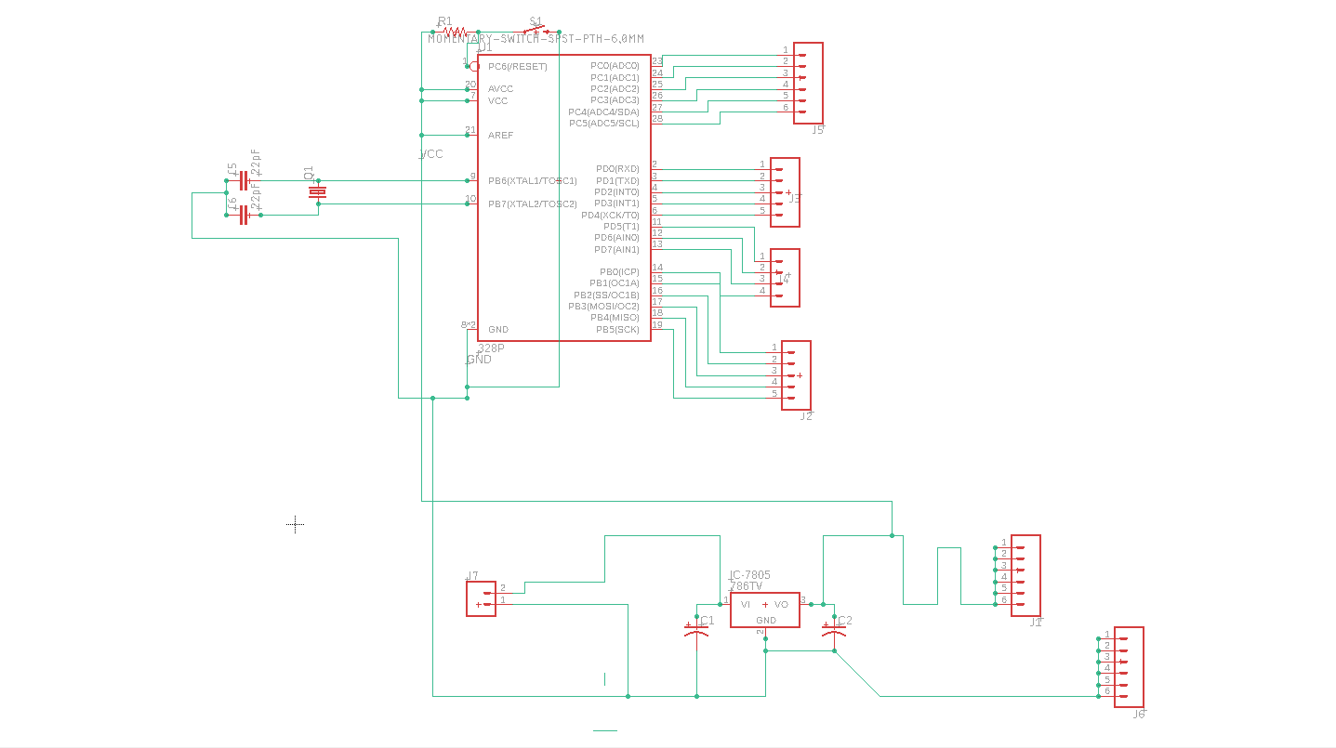
Step 2: Soldering the Eletronics

Slide 6
WHAT YOU NEED TO KNOW:
Before starting to solder, you need to observe the figure above.
Relative to the H-bridge, you have to connect enable A and enable B to the positive pin (which is by its side, just use a jumper) otherwise the motors wont run.
Then, connect each motor to a terminal positive and negative from the H-bridge (the side pins with the screws), and the three connectors remaining with screws are: the ground, which will go to the arduino and all other devices, including the battery, the positive 9V-12V that comes exclusively from the battery, and the 5V out that will supply all other devices that are not the DC motors.
The for remaining connectors are two pairs of logic signals to control the direction and power given to each motor.

Slide 7
THE PINOUT:
HC-06 Bluetooth;
PIN 0 - RX >>> Arduino Digital Pin 0;
PIN 1 - TX >>> Arduino Digital Pin 1;
PIN 2 - GND>>> GND;
PIN 3 - VCC>>> VCC 5V;

Slide 8
Dual H-bridge; PIN 0 >>> Arduino Digital Pin 4; PIN 1 >>> Arduino Digital Pin 5; PIN 2 >>> Arduino Digital Pin 6; PIN 3 >>> Arduino Digital Pin 7; Enable A >>> VCC; Enable B >>> VCC; Power >>> Battery Positive 9 - 12V; GND >>> Battery GND IC GND; +5V OUT >>> IC VCC;

